Slide 1
Chapter 5: Accounting for Retail Businesses
Financial & Managerial Accounting, 16e

Slide 2
Financial Statements
The revenue activities of a merchandising business involve the buying and selling of merchandise.
A merchandising business first purchases merchandise to sell to its customers.
When this merchandise is sold, the revenue is reported as sales, and its cost is recognized as an expense called cost of goods sold or cost of merchandise sold.
The cost of goods sold is subtracted from sales to arrive at gross profit, which is the profit before deducting operating expenses.

Slide 3
Financial Statements
Merchandise on hand (not sold) at the end of an accounting period is called inventory or merchandise inventory.
Inventory is reported as a current asset on the balance sheet.

Slide 4
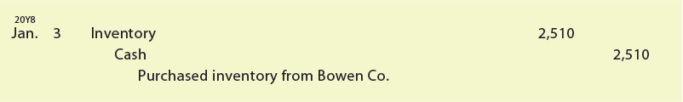

Purchases Transactions
Under the perpetual inventory system, cash purchases of merchandise are recorded as follows:
The T account postings for the preceding journal entry are as follows:

Slide 5
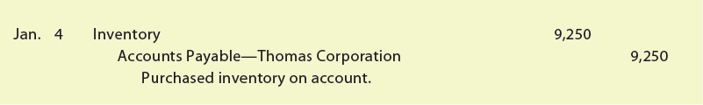

Purchases Transactions
Purchases of inventory on account are recorded as follows:
The T account postings for the preceding journal entry are as follows:
The terms of purchases on account are normally indicated on the invoice or bill that the seller sends the buyer.

Slide 6
Purchases Transactions
The terms for when payments for merchandise are to be made are called the credit terms.
If payment is required on delivery, the terms are cash or net cash.
Otherwise, the buyer is allowed an amount of time, known as the credit period, in which to pay.
The credit period usually begins with the date of the sale as shown on the invoice.

Slide 7
Purchases Discounts
For example, a supplier may offer a 2% discount if the buyer pays within 10 days of the invoice date. If the buyer does not take the discount, the total invoice amount is due within 30 days.
These terms are expressed as 2/10, n/30 and are read as “2% discount if paid within 10 days, net amount due within 30 days.”

Slide 8
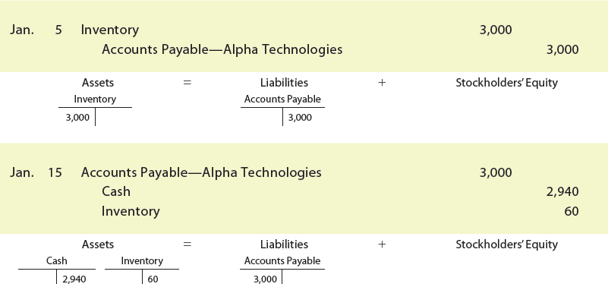
Purchases Discounts
Assume that NetSolutions places an order for $3,000 from Alpha Technologies on January 5 with terms of 2/10, n/30.

Slide 9
Purchases Discounts
In order to pay the invoice on January 15 (the last day of the discount period), NetSolutions pays $2,940, which is $3,000 less the discount of $60 ($3,000 × 2%).

Slide 10
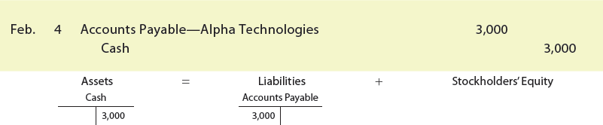
Purchases Discounts
Assume that NetSolutions does not take the discount, but instead pays the invoice on February 4. In this case, NetSolutions would record the payment as follows:

Slide 11
Sales on Account
A retail business may sell merchandise on account.
The seller records such sales as a debit to Accounts Receivable and a credit to Sales.

Slide 12
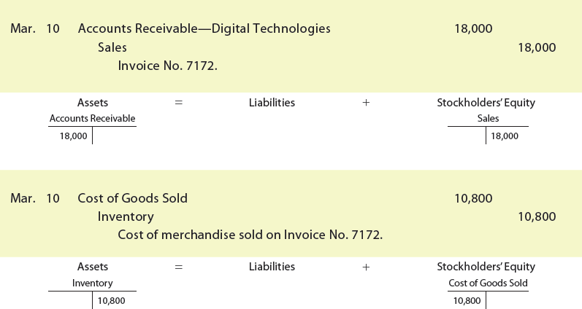
Sales on Account
To illustrate, assume that NetSolutions sold merchandise on account to Digital Technologies for $18,000, terms n/30.
The cost of the merchandise sold was $10,800. NetSolutions would record the sale on account as follows:

Slide 13
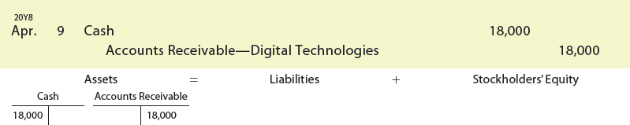
Sales on Account (3 of 3)
NetSolutions would record the receipt of Digital Technologies’ payment on April 9 as follows:

Slide 14
Freight
The ownership of the merchandise may pass to the buyer when the seller delivers the merchandise to the freight carrier.
In this case, the terms are said to be FOB (free on board) shipping point.
This term means that the buyer pays the freight costs from the shipping point to the final destination.
Such costs are part of the buyer’s total cost of purchasing inventory and are added to the cost of the inventory by debiting Inventory.

Slide 15
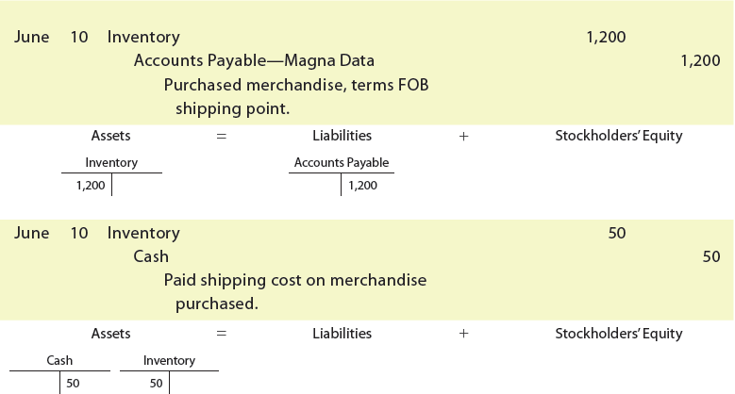
Freight
To illustrate, assume that on June 10, NetSolutions purchased merchandise as follows:
June 10. Purchased merchandise from Magna Data, $1,200 terms FOB shipping point.
10. Paid freight of $50 on June 10 purchase from Magna Data.
NetSolutions would record these two transactions as follows:

Slide 16
Freight
The ownership of the merchandise may pass to the buyer when the buyer receives the merchandise.
In this case, the terms are said to be FOB (free on board) destination.
This term means that the seller pays the freight costs from the shipping point to the buyer’s final destination.
When the seller pays the delivery charges, the seller debits Delivery Expense or Freight Out.
Delivery Expense is reported on the seller’s income statement as a selling expense.

Slide 17
Freight
Assume that NetSolutions sells merchandise as follows:
June 15. Sold merchandise to Kranz Company on account, $700, terms FOB destination. The cost of the goods sold is $480.
15. NetSolutions pays freight of $40 on the sale of June 15.
NetSolutions records the sale, the cost of the sale, and the freight cost as follows:

Slide 18
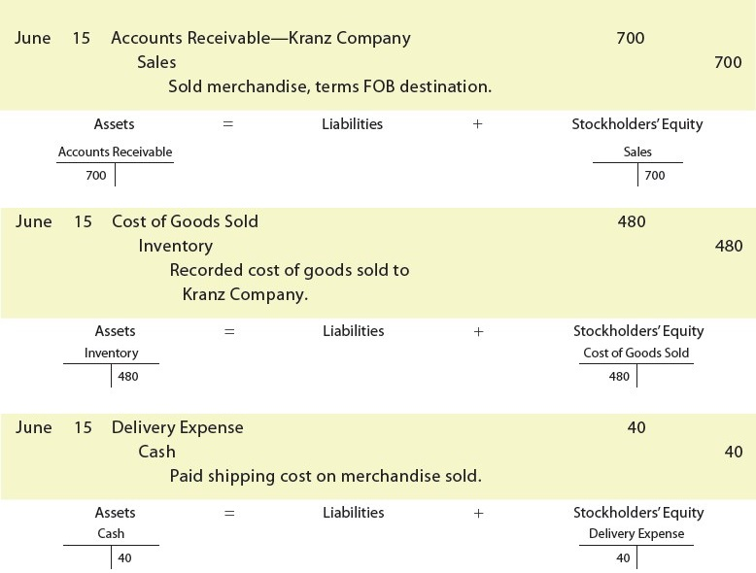
Freight (4 of 6)

Slide 19
Freight
The seller may prepay the freight, even though the terms are FOB shipping point. The seller will then add the freight to the invoice.
The buyer debits Inventory for the total amount of the invoice, including the freight.
Any discount terms would not apply to the prepaid freight.

Slide 20
Freight
Assume that NetSolutions sells merchandise as follows:
June 20. Sold merchandise to Planter Company on account, $800, terms FOB shipping point. NetSolutions paid freight of $45, which was added to the invoice. The cost of the goods sold is $360.
NetSolutions records the sale, the cost of the sale, and the freight as follows:

Slide 21
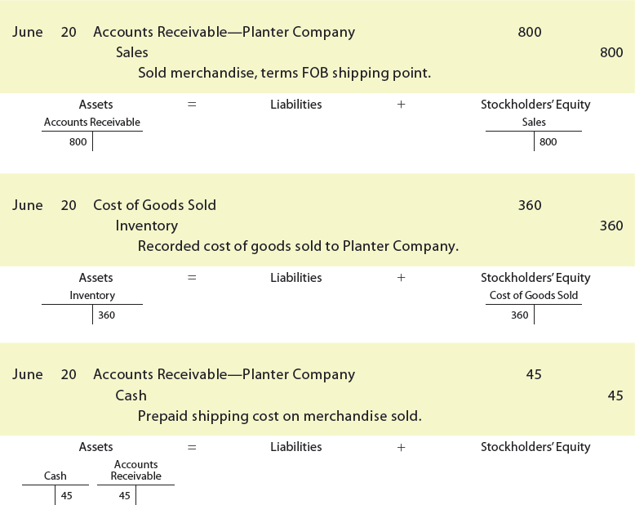
Freight (6 of 6)

Slide 22
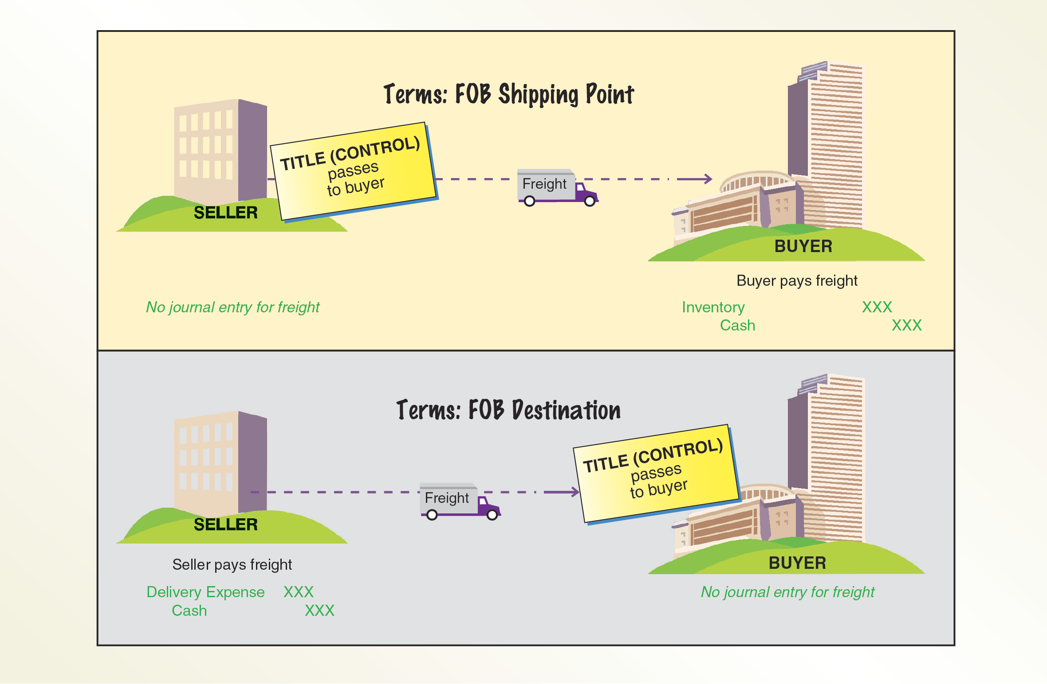
Freight Terms

